Slide 1
Mini Project-OOPs through Java Snake Game
Presenting by
K.NAGAVARDHAN(227R1A0529)

Slide 2
CONTENTS:
Abstract
Introduction
Literature Survey
Design
Hardware and Software requirements
Implementation
Result
Conclusion

Slide 3
Abstract
Snake game is a simple console application without graphics. In this project, you can play the popular "Snake Game" just like you played it elsewhere. You have to use the up, down, right or left arrows to move the snake. Foods are provided at the several co-ordinates of the screen for the snake to cat.
Every time the snake eats the food, its length will by increased by one element along with the score. I have used JAVA as Programming language for writing the code for the project and Notepad for writing the programs. Operating system used Windows 10.
. The implementation showcases the importance of event-driven programming through the incorporation of key listeners and timers to facilitate user input and game state updates. The report elucidates the modular structure of the codebase , delineating the distinct responsibilities of the Snake, Food, and Game Board classes.

Slide 4
Introduction
Playing games is fun and exciting it gives us relief from stress and unwind from our stressful works. Many of us spend our vacant time or others that use most of their time in playing and exploring new games. Today, with the rapid development of technology we have, games that are rising up together with it.
Nowadays with the technology we have many games that are developing for computer most specifically for windows. With the high technology equipped with these computers, computer games become robust and attract many people to buy or have this gadget for them to experience what's inside it which makes it a trend for the new generation of gadget.
Snake game is a computer action game; whose goal is to control a snake to move and collect food in a map. It has been around since the earliest days of home computing and has re-emerged in recent years on mobile phones.
To move the snake, use 'up arrow' for up, down arrow for down , 'left arrow' for left and right arrow' for right. Press 'Q' to exit the game at any time, press "C' to continue the game. The aim of the game is to collect the dots (food) and avoid the obstacles (crosses borders). As you collect the food, the snake gets longer. The score also increases. There is no

Slide 5
Literature survey
The history of the Snake game goes back to the 1970's, the concept originated in the 1976 arcade game Blockade, and its simplicity has led to many implementations. However, it was the 1980'swhen the game took on the look that we will be using.
It was sold under numerous names and many platforms but probably gained widespread recognition when it was shipped as standard on Nokia mobile phones in the late 1990's.
The first published Nokia, for monochrome phones. It was programmed in 1997 by “Taneli Armanto” of Nokia and introduced on the Nokia 6110. The game involves controlling a single block or snakehead by turning only left or right by ninety degrees until you manage to eat an block.
When you get the block, the Snake grows an extra block or body segment. If, or rather when, he snake bumps into the edge of the screen or accidentally eats himself the game is over . The more blocks the snake eat the higher the score.

Slide 6
Hardware and Software requirement
System requirements:
Operating system: windows xp or higher
Ide: Notepad and Jdk (any version)
Front end: windows
Language: Java
Hardware requirements:
Intel P4 1.5GHz or above
512MB RAM
80GB HDD Minimum

Slide 7
WORKING ALGORITHM
Let's look at how a program to run the whole game might look:
1. Draw the playing area with bounding rectangle, set the counter to zero and display it.
2. Draw the snake in a starting position.
3. Draw the food in a starting location.
4. On user input, change snake direction.
5. Move the snake one move
6. If the snake is over food, eat it, increase the score, grow, move the food.
7. else if the snake is over in a wall, die.

Slide 8
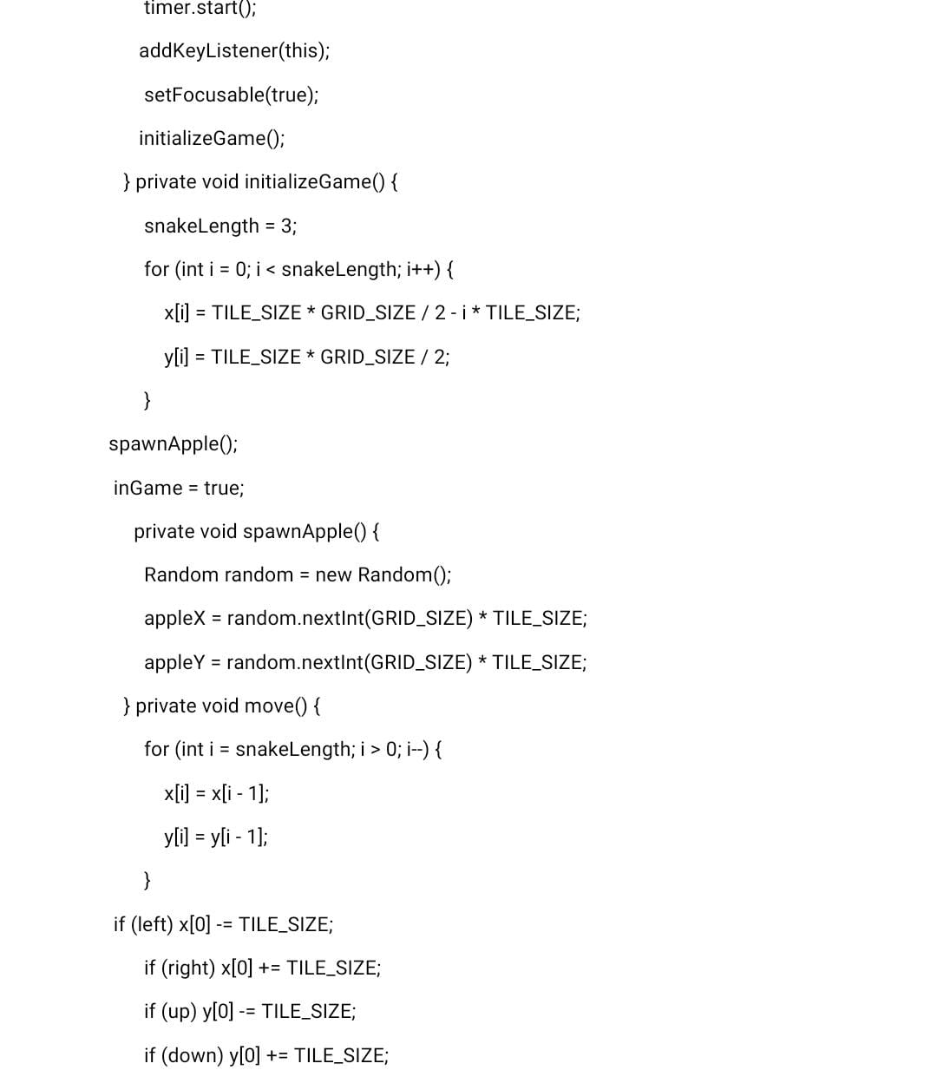
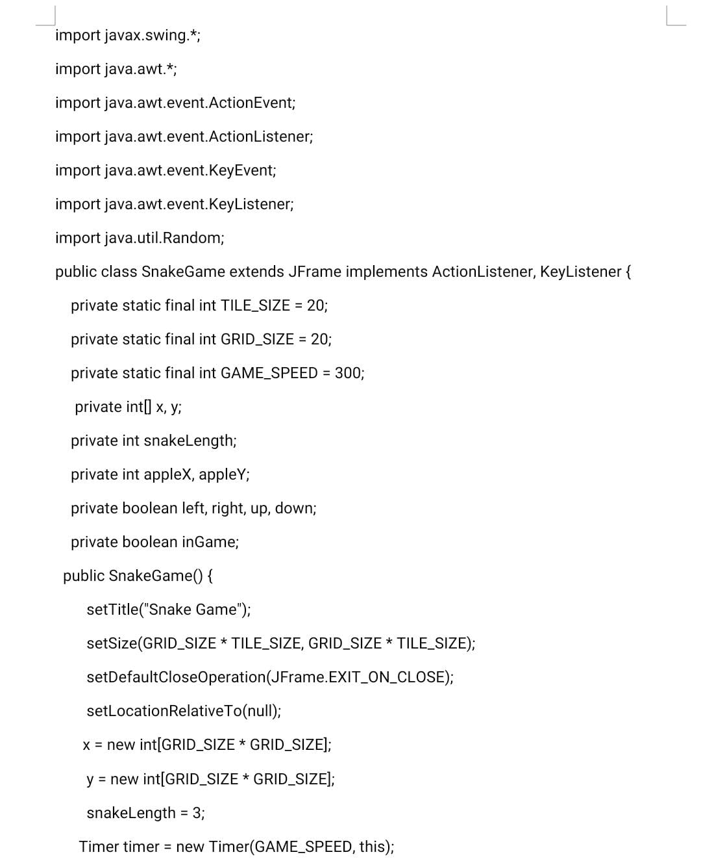
Implementation:

Slide 9
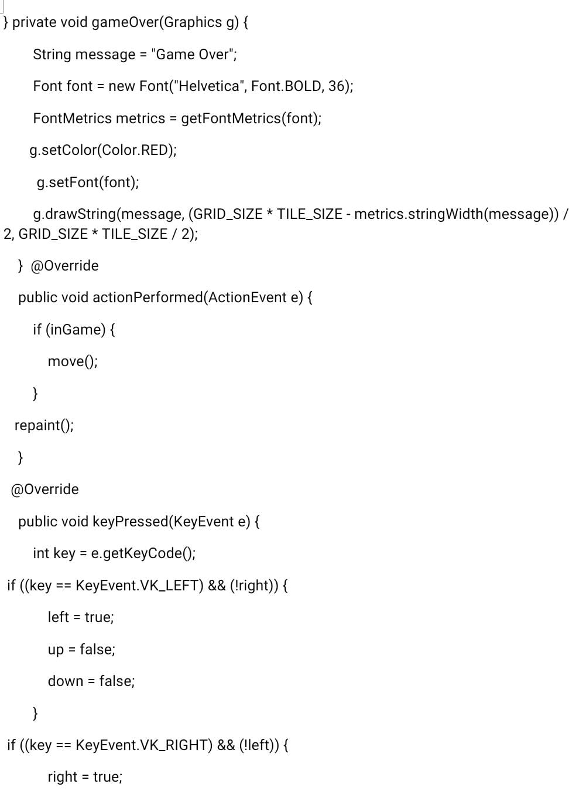
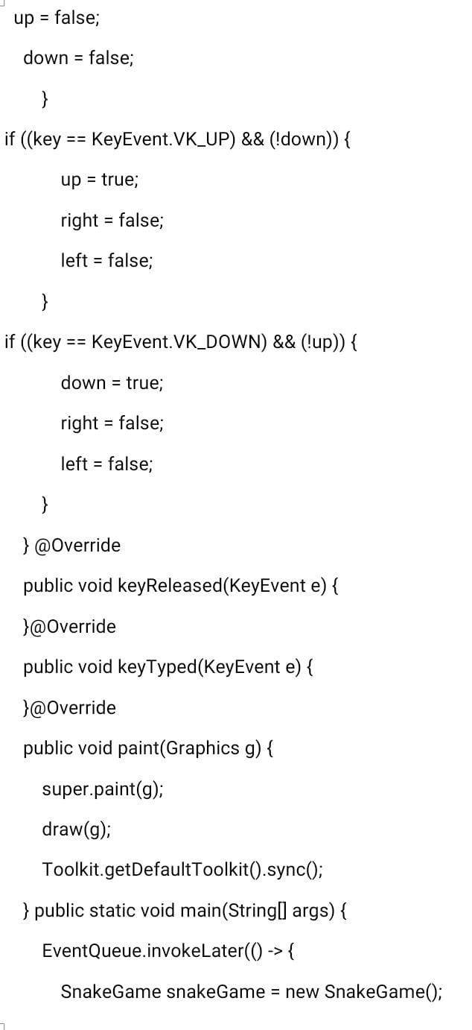

Slide 10
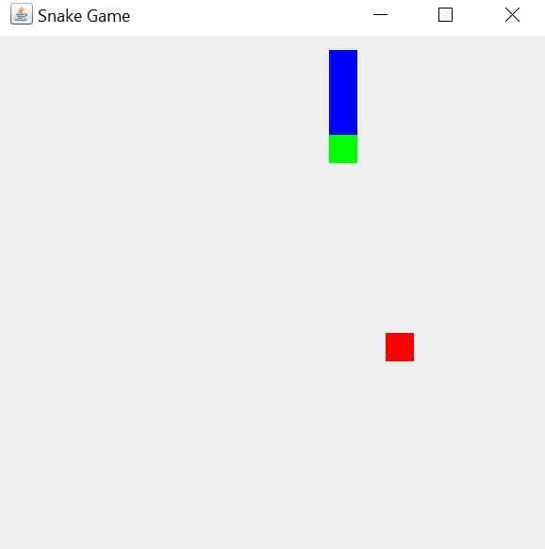
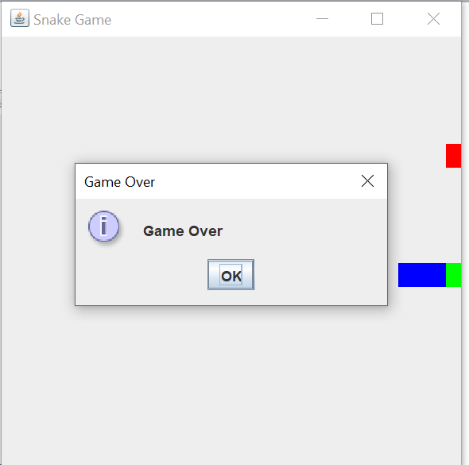
Result:

Slide 11
Conclusion
In conclusion, the Snake game implemented in Java successfully demonstrates key programming concepts such as object-oriented design, user input handling, and game loop implementation.
The game provides an engaging user experience with smooth controls and dynamic gameplay. Future enhancements could include additional features, levels, or optimizations for an even more polished gaming experience.

Slide 12


